Slide 1
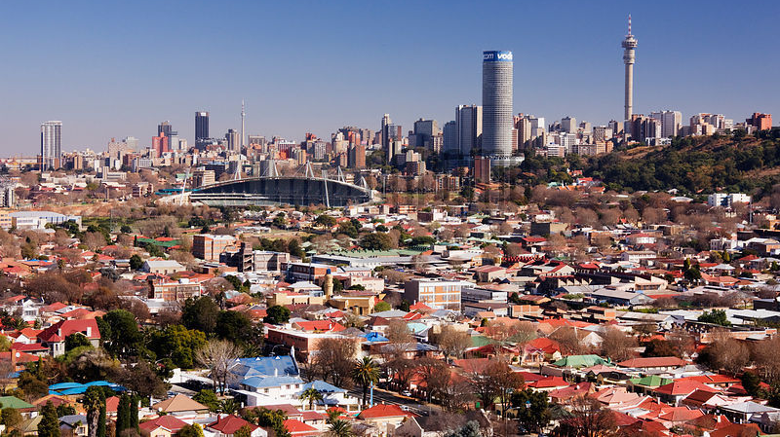
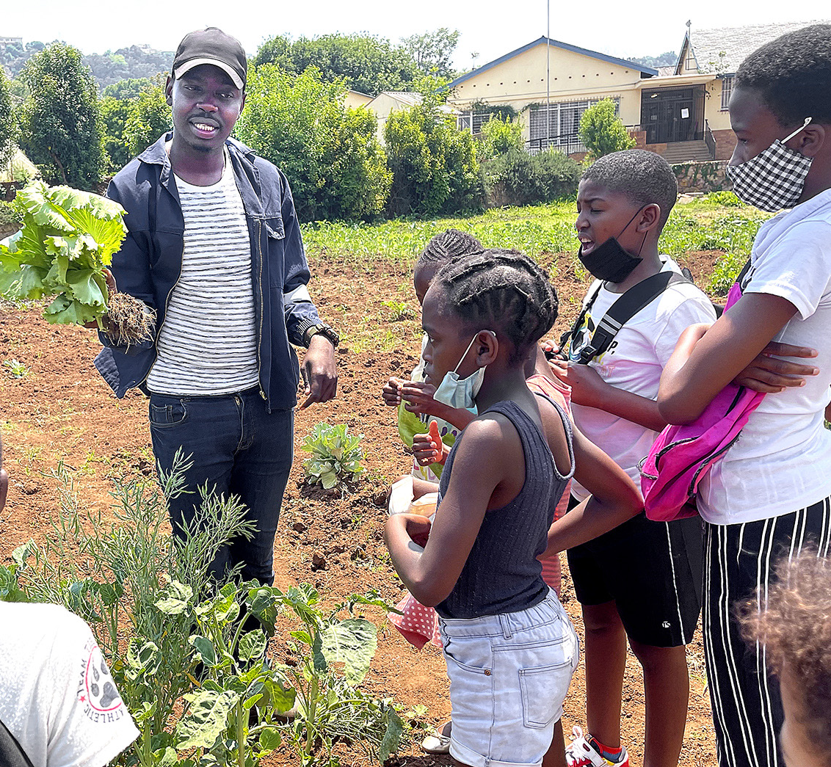

EcoJozi
Muneer Alsahli, Adan Khan, Hassan Sakka, Ryan O’Neill-Quinn, Hein Htet Aung, Joshua Dennison, Clive Nyamadzawo
Notes:
Makers Valley: Joburg children follow the food journey — from the farm to their plates Makers Valley visit: Joburg children follow the food journey — from the farm to their plates Johannesburg Travel Guide

Slide 2
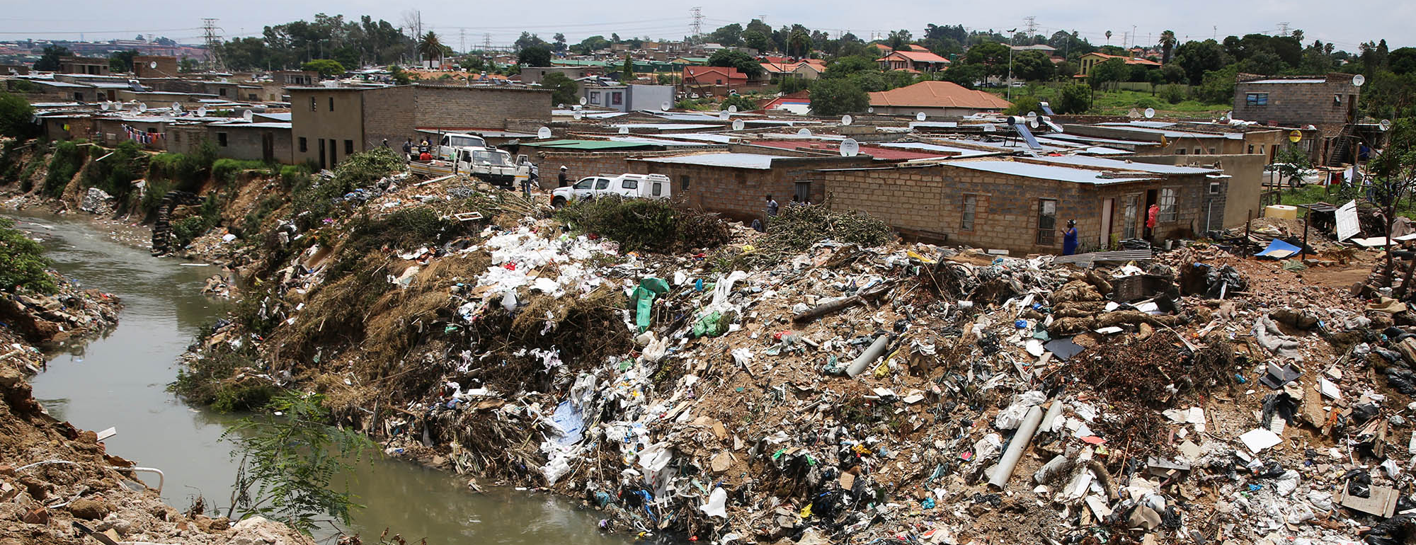
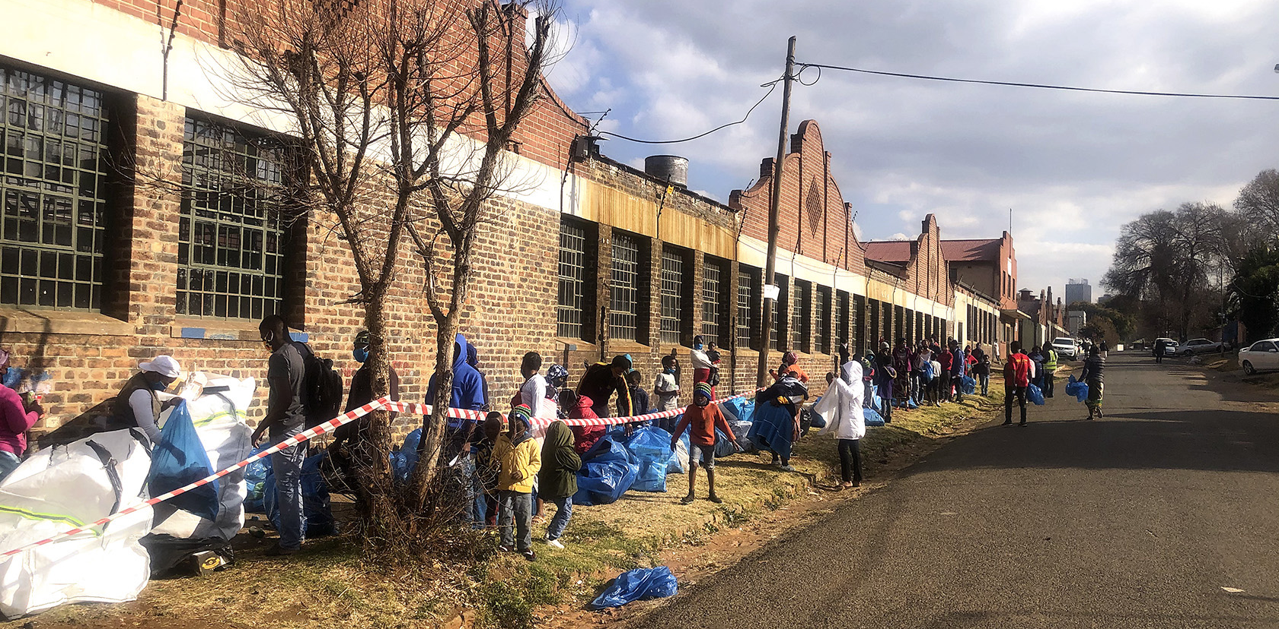
Why waste management?
1.4 million tonnes of waste generated annually
Only 10% recycled with most of the waste being burning or illegally dumped
Causes environmental hazards such as air quality
Affects public health
Notes:
Makers Valley, Johannesburg: In the midst of crisis, a network of possibility
https://www.dailymaverick.co.za/article/2022-07-06-waste-is-one-of-joburgs-biggest-environmental-challenges-says-councillor/

Slide 3
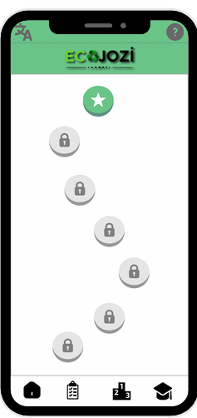
What is our solution
Our mobile app allows users to:
Identify recyclable and non recyclable waste
Find or report garbage sites using a live waste map with the help of partners and community reports
Navigate to cleanup locations with AR guidance
Earn Points & Rewards
An innovative platform that combines technology, gamification and community engagement
To make waste management easier and more rewarding

Slide 4
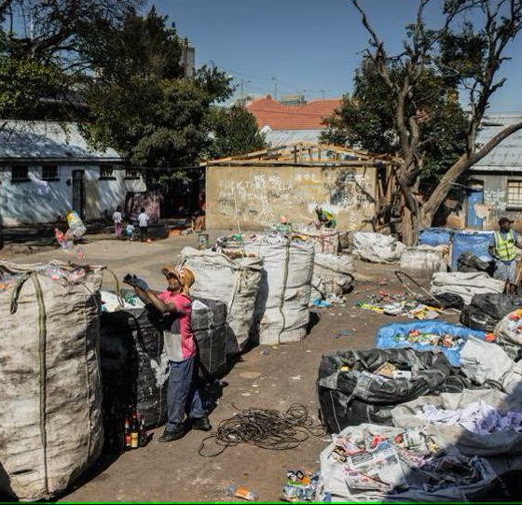
Community Engagment
Workshops in churches, youth centres and community hubs
Ensures that everyone can participate
Regardless of access to technology
Notes:
Photos: Living off garbage in South Africa’s Johannesburg

Slide 5
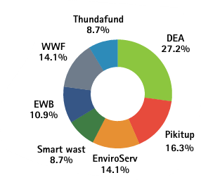
Funding
We have partnered with :
WWF
Pikitup
DEA
EnviroServ
Smartwaste
Thunderfund
Engineers Without Borders
Securing £30,000-£40,000 in funding
This will help us expand outreach and ensure long term sustainability

Slide 6


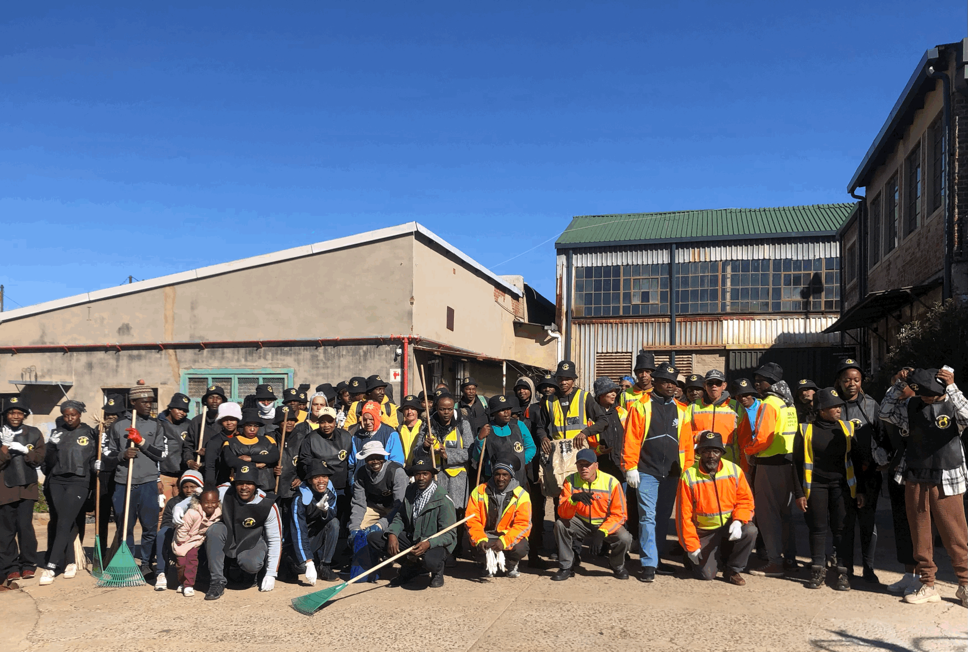
The Bigger Picture
Making waste management interactive and rewarding
Reduce illegal dumping
Improve recycling rates
Create a cleaner, healthier city

Slide 7
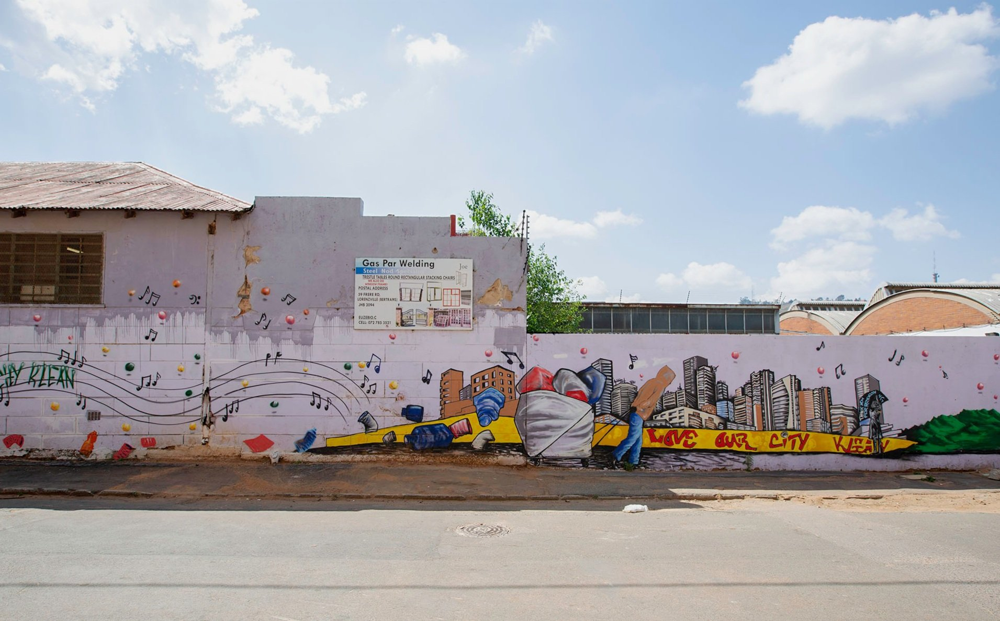
Our Vision for the Future
EcoJozi is more than just an app
Aiming for a cleaner, healthier Johannesburg
Turning trash into treasure
Notes:
https://th.bing.com/th/id/OIP.7Na_iIg_IjbJ6MDqpIS-3gHaEm?w=313&h=194&c=7&r=0&o=5&dpr=1.4&pid=1.7

